Slide 1
Shekar: A Python library for Persian NLP An Open-Source Toolkit for Processing and Understanding Persian Language Data
Presented by Ahmad Amirivojdan
CS540 – Advanced Software Engineering
Spring 2025

Slide 2
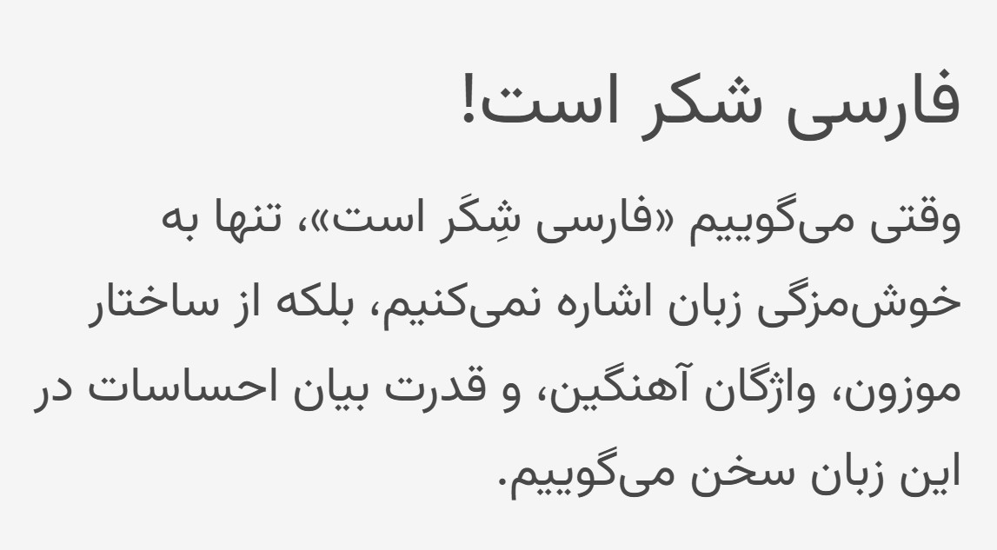
Introduction
Despite being spoken by over 100 million people in Iran, Tajikstan, and Afghanstan, Uzbekistan, Persian remains underrepresented in the NLP ecosystem.
Challenges in Persian NLP
Multiple Unicode representations
prefixes/suffixes for negation, possession, plurality
Space does not always separate words
Zero-width non-joiner complicates segmentation
Formal vs Informal Language
Lack of high-quality annotated corpora

Slide 3
Prior Works
Existing Libraries:
Hazm – Basic NLP pipeline but limited extensibility and outdated models
DadmaTools – Richer toolset but lacks standardization and modern embeddings
Limitations in Prior Work:
Not modular and customizable
Poor support for colloquial Persian
Limited use of large-scale modern corpora like Telegram or Naab
Minimal documentation and sparse community support

Slide 4
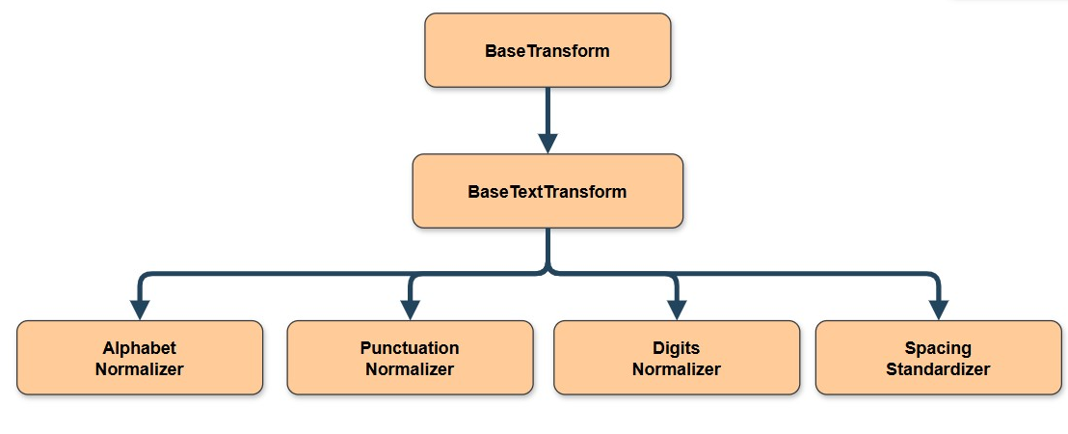
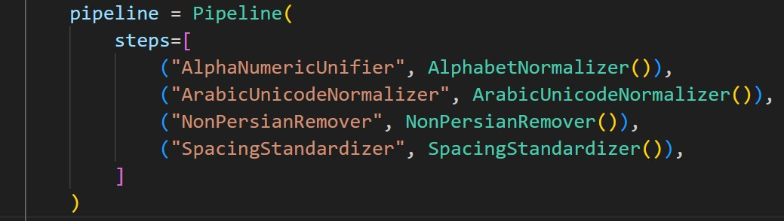
Normalizer
AlphabetNormalizer
ArabicUnicodeNormalizer
NumericNormalizer
PunctuationNormalizer
PunctuationRemover
DiacriticsRemover
RedundantCharacterRemover
NonPersianRemover
StopwordRemover
SpacingStandardizer

Slide 5
Experimental Comparison
 | Tweeter (87mb) | BCC News (145mb) | Persepolis Fanclub (58mb)
Hazm | 191s | 165s | 187s
Dadmatools | 31s | 39s | 32s
Shekar | 29s | 38s | 45s

Slide 6
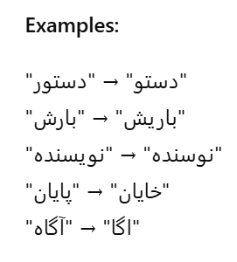
Statistical Spell Checker
Key Technique
Corpus = Wikipedia + PersianBlog + Telegram Channels
Pre-compiled normalized dictionary for fast lookups
Generate all candidate words within n edits (insertion, deletion, substitution)
Filter candidates by existence in dictionary
Rank candidates by:
Unigram frequency
Minimum edit operations

Slide 7


Embeddings
Model | Dimensions | Dataset | Intrinsic Evaluation (Clustering Acc)
FastText CBOW | 100 | Persian Blogs (600 mb) | 0.82
FastText CBOW | 300 | Naab (130 gb) | 0.80
BERT-Base | 768 | Persian Blogs | 0.70

Slide 8
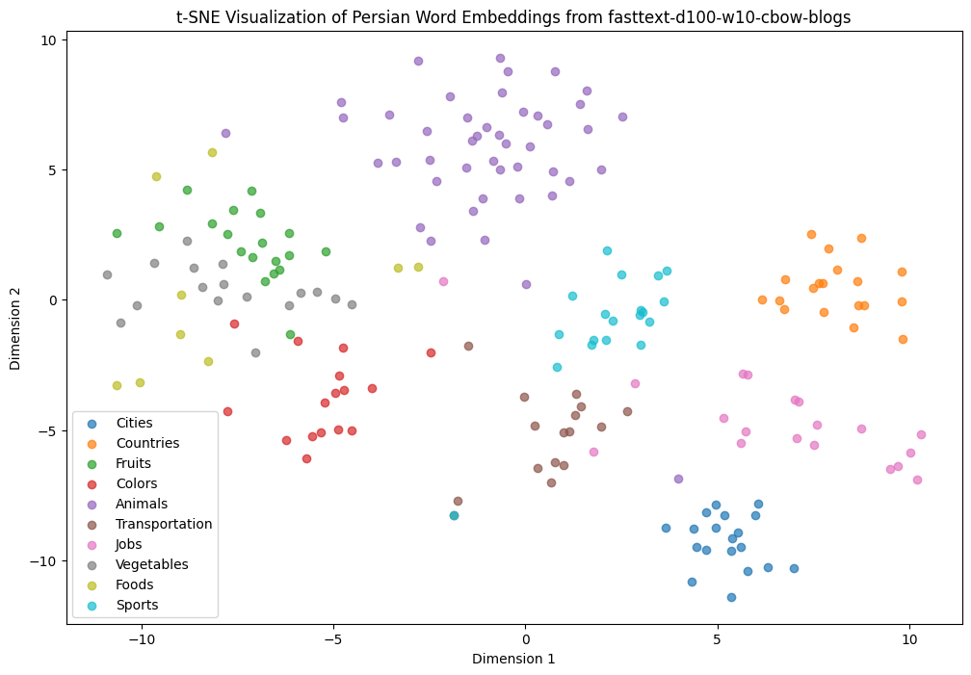
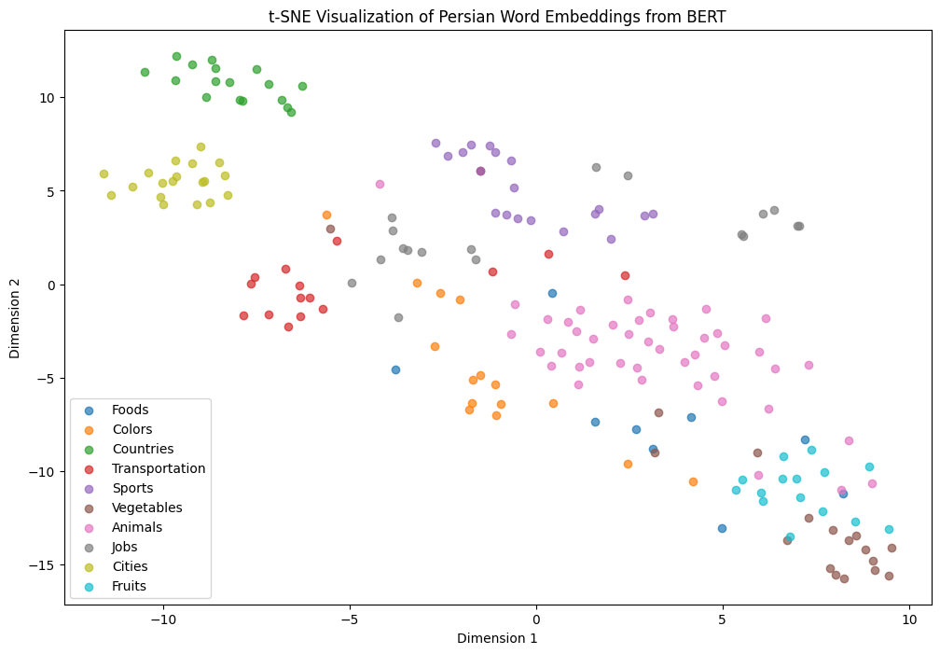
Embeddings
FastText Embeddings - 100D
BERT Embeddings - 756D

Slide 9
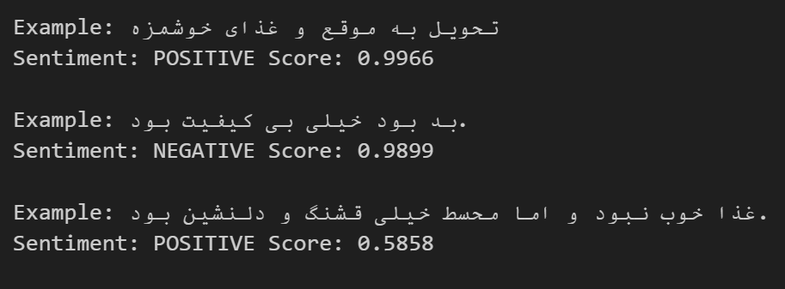
Sentiment Analysis
Epoch | Training Loss | Validation Loss | Accuracy
1 | 0.389300 | 0.311553 | 0.868286
2 | 0.287200 | 0.300371 | 0.876857
3 | 0.255100 | 0.316058 | 0.873000
SnapFood sentiment dataset
Accuracy : 0.87
Loss: 0.31

Slide 10
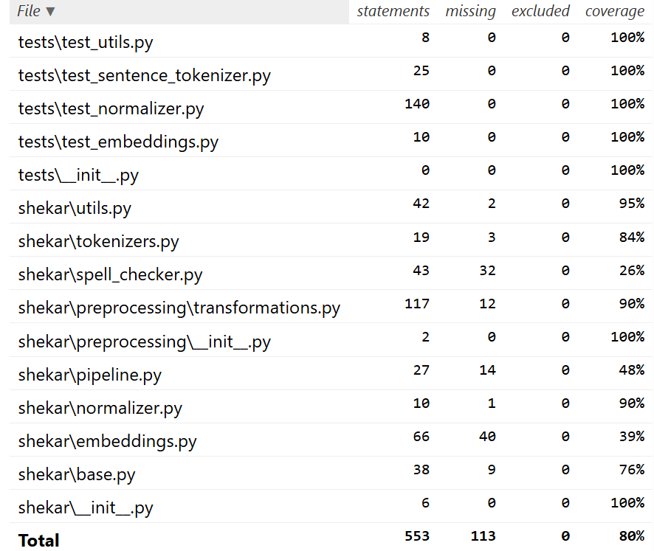
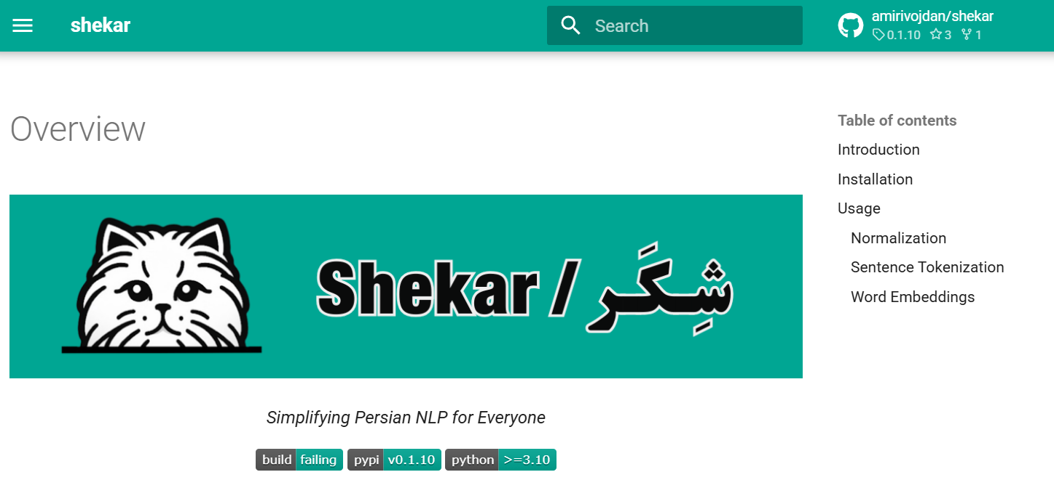
Testing & Documentation
Over 100 test cases resulting in %80 coverage
Documents available at https://lib.shekar.io/ (served on cloudflare pages)

Slide 11
Future Works
Pretraning SOTAmodels like ModernBert
POS Tagger (BERT-based)
Context-aware tagging
Handles ambiguous cases and informal language
Named Entity Recognition (NER)
Detect and classify entities like names, locations, dates
Crucial for information extraction and QA

Slide 12
Questions?

